Slide 1
Repeating the Name
A Hindu way to keep in conscious contact with a Higher Power

Slide 2
From The Cloud of Unknowing
“Never let go of your purpose and don’t let anything take away your longing for God. With the sharp spear of your love, never stop beating on the cloud of unknowing that is between you and your God.”

Slide 3
The Mantra
In its highest form, a very complex and sacred verbal formula with many levels of meaning
God is present in the mantra
“A combination of sacred syllables that serves as a magnet to attract or a lens to focus spiritual vibrations”—Swami Radha
“A mantra has the power of releasing the cosmic and supra-cosmic consciousness.”—Swami Radha
Ideally, chosen and given by a guru
Also used to obtain luck and power!

Slide 4
For our purposes…
Most basic mantra is one of the Names of God
To keep up our conscious contact
No guru needed
To push away distraction
(Like giving an elephant a stick)
To repeat continuously whenever we want, during meditation AND at other times
Mentally, with moving lips, aloud, written
To remind us of God’s presence always
To move closer to God with each repetition

Slide 5
Devas: Three Hindu Ways to God
Shiva
Vishnu/Krishna
The Goddess, or Divine Mother

Slide 6
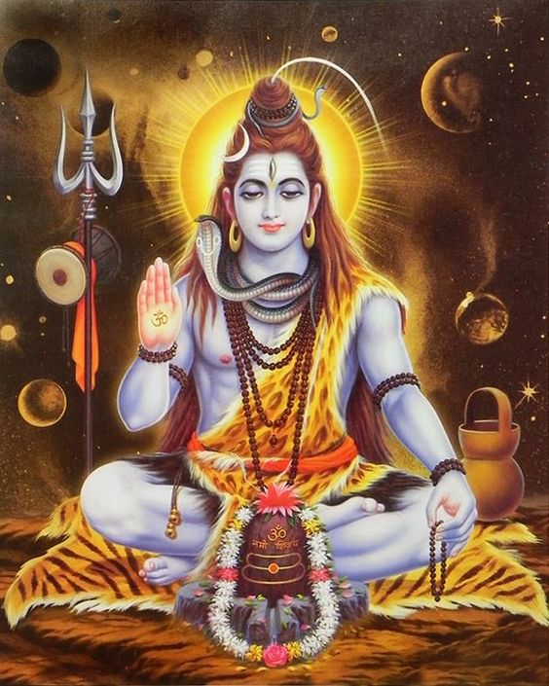
Shiva
Yoga, meditation, liberation; a more intellectual approach to God

Slide 7
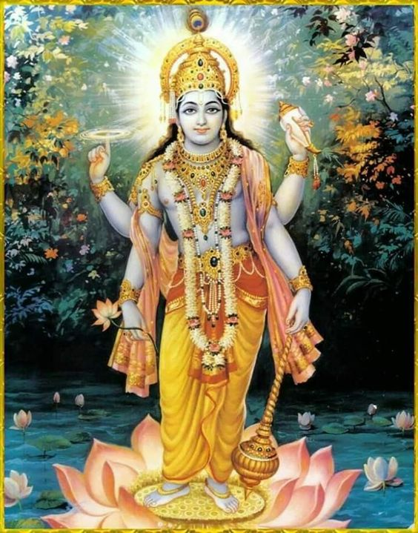
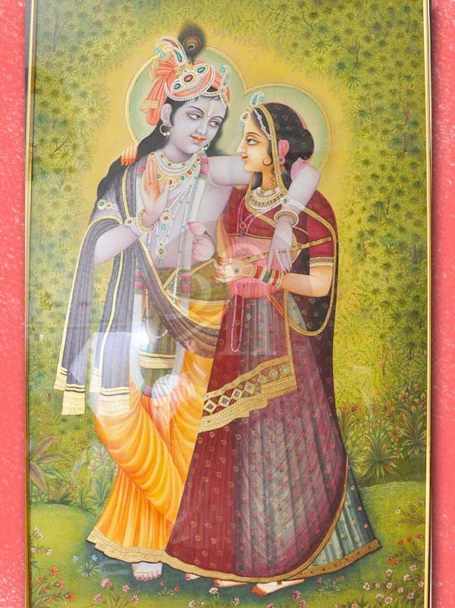
Vishnu/Krishna
Devotion; a more emotional, personal approach to God

Slide 8
The Goddess, or Divine Mother
Lakshmi, Durga, Sarasvati: Prosperity, Power, Arts—a path of devotion and yoga

Slide 9
Ram, a Special Case
Refers to Lord Rama, a great mythic hero and incarnation of God
This form of his name is used independently of Lord Rama’s story as a name for God by both Hindus and Sikhs
“Ram, Ram, Ram” was the Name of God that Mahatma Gandhi repeated all his life; it was on his lips when he was assassinated in 1948.

Slide 10
Nama Japa for the Various Devas
Shiva: “Om Namah Shivaya”
Vishnu: “Om Namo Narayanaya”
Krishna/Rama: “Hare Krishna, Hare Krishna, Krishna Krishna, Hare, Hare. Hare Rama, Hare Rama, Rama Rama Hare hare”
The [Mother] Goddess: “Jai Mata Di”
Ram: “Ram, Ram, Ram”… or “Sri Ram, Jai Ram, Jai Jai Ram”

Slide 11
Nama Japa in Christianity
The Jesus Prayer: “Lord Jesus Christ [Son of God] [Have mercy upon me] [a sinner.]”
St. Francis’ Nama Japa: “My God and my all”
Catholic “ejaculations”: “Jesus, Mary, and Joseph,” “Lord, have mercy,” “Lord, make haste to help me.”
John Main’s Christian Meditation: mantras like “Maranatha.” One listens to the mantra.

Slide 12
12-Step Nama Japa?
“Higher Power, help me.”
“HP, HP, HP…”
O God of my understanding”
“Thank you, God, for everything”
Yours?

Slide 13
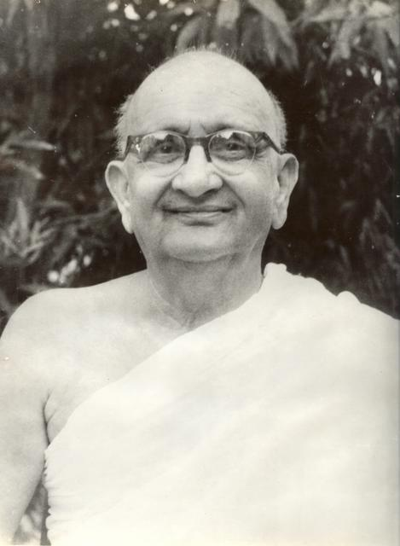
Swami Ramdas (1884-1963)

Slide 14
“With the Name on your lips you can withstand all the storms of life, you can brave all the dangers, all the disappointments, and all the losses that attend on life….Make it a rule to repeat the Name at all times and in all places. There are no restrictions with regard to taking the divine Name.” –Swami Ramdas

Slide 15
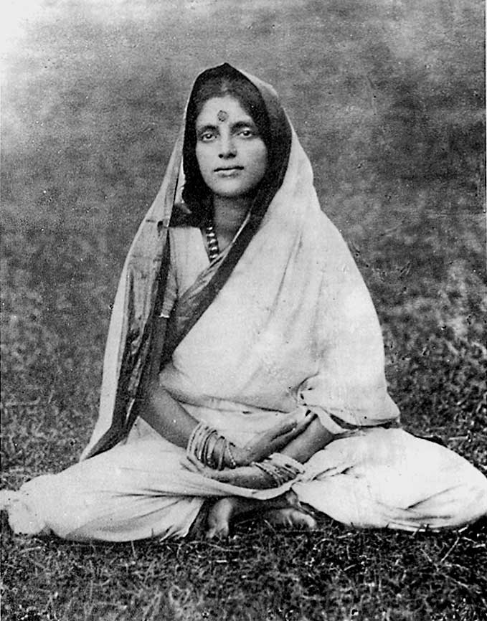
Anandamayi Ma (1896-1982)

Slide 16
“It is possible to practise God’s Name under the most adverse circumstances. He causes everything to happen and is therefore ever near.” –Anandamayi Ma
“While living your life in the world, endeavor to invoke Him at all times, whether you feel the inclination or not. Trials and tribulations will thereby love power to distress you.” – Anandamayi Ma

Slide 17
When to Practice Nama Japa
At meditation time
Waiting in line at the DMV/grocery store / bank /
Lying in bed before sleep
When you think of it
At a red light
Walking the dog
Walking
All other times

Slide 18
“The will to realize God is itself happiness….Even the feeling of the absence of God is God’s manifestation, so that God’s presence may be realized.” –Anandamayi Ma

